Slide 1
Project Summary

Slide 2
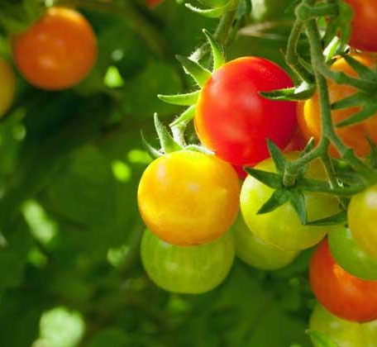
Introduction
Excessive use of pesticides
Precision agriculture
Healthier planet

Slide 3
Review
Convolutional Neural Network Arch
Building blocks review
Platforms
FPGA vs GPU vs CPU
DSP chips
Model Architectures <Abdo> (2.3)
Conv2D vs DWS Conv2D evaluation
MobileNetV1 Architecture

Slide 4
Implementation
Model Training <Menz> (3.1)
Classes
Image augments
Accuracy paradox
Width & Resolutions Multipliers
Google Colab Model Training Suite
Run time restrictions
Models metrics

Slide 5
Implementation
2. Custom CNN Implementation <Menz> (3.2)
TF not supported
9 Building blocks review
Understand and reconstruct their optimized implementations
Google Colab Debug suite
LL Functions & TL Functions
Samples & Examples
Metrics (TF vs Custom)

Slide 6
Implementation
3. System Functional Simulation <Menz> (3.3)
Model & SPP interfacing protocol simulation
Threading for real time emulation
Shared memory testing
Polling
Block diagrams
Metrics (PC & Google & HPS)

Slide 7
Implementation
4. Custom Single Purpose Processor <Tarek & Salem> (3.4)
From algorithm to HDL flow
Initial design and matmul algorithm
VHDL coding
Testbench and simulation
Block diagrams

Slide 8
Implementation
5. Avalon Bus MM Interface <Tarek> (3.5)
Bus specifications
Interconnects Diagrams

Slide 9
Implementation
6. Custom Peripheral <Menz & Tarek> (3.6)
Wrapper implementation
Custom Peripheral Specifications
Top Level & Interface Level
Protocol Diagrams

Slide 10
Implementation
7. System Implementation <Menz> (3.7)
Python & Shared Memory interaction flow (Reg & BRAM)
Metrics
Evaluation
Limitations
Future work

